Slide 1
DS 102: Matching Markets
Lecture 20
Michael Jordan, Lydia Liu, & Horia Mania
University of California, Berkeley

Slide 2
DS 102
(A Lecture 1 Slide)
Unusually, this course will focus more on decision making and less on pattern recognition
Decision-oriented topics that we’ll cover include false-discovery rate control, bandit algorithms, causal inference, matching markets, and reinforcement learning
We’re trying to prepare you for the next wave, not the preceding wave!

Slide 3
Decisions and Context
(A Lecture 1 Slide)
Real-world decisions with consequences
counterfactuals, provenance, relevance, causal inference, dialog
Sets of decisions across a network
false-discovery rate (instead of sensitivity/specificity/accuracy)
Sets of decisions across a network over time
streaming, asynchronous decisions
Decisions when there is scarcity and competition
need for an economic perspective
Decisions which affect future data and future decisions
need for a dynamical-systems, control-theoretic perspective
Decisions when there are consequences for others
need for an ethical perspective

Slide 4

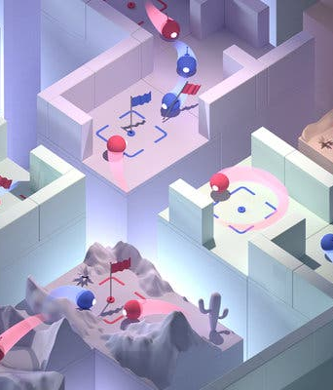

Data, Decisions ... and Economics
Matching Markets
Auctions
Multiplayer games

Slide 5
Two-Sided Markets
Markets often have two sides, producers and consumers (or supply and demand) which must be matched
Matching med-school students and hospitals is a classic example (Roth 1984)
med-school students have preferences over hospitals and hospitals have preferences over med-school students
The kidney-exchange market is another classic example

Slide 6
Two-Sided Markets: Bands and Drummers
Bands
Drummers

Slide 7
Preferences on Both Sides
Bands
Drummers

Slide 8
How Should We Match Supply and Demand?
Definition: a matching M is a set of pairs (b, d) such that
Each band b appears in at most one pair in M.
Each drummer d appears in at most one pair in M.
Goal: given a set of preferences among bands and drummers, determine a matching that is an equilibrium.
Definition: a blocking pair (b, d) is a pair such that:
b prefers d to its current match
d prefers b to its current match
(if someone is not matched with anyone, we think of them as being matched with themselves)

Slide 9
Stable Matchings
Definition: a stable matching is a matching with no blocking pairs.
Question: is the following matching a stable matching?
Bands
Drummers
Answer: No, is a blocking pair.

Slide 10
Finding Stable Matchings
Observation: the following matching is a stable matching.
Bands
Drummers

Slide 11
Question: can we always find a stable matching?
Answer: Yes. In 1962 Gale and Shapley showed that a simple and natural algorithm always finds a stable matching

Slide 12
The Gale-Shapley Deferred Acceptance Algorithm
GS (preference lists of bands and drummers):
INITIALIZE M to empty matching
WHILE (some band b is unmatched and hasn’t proposed to every drummer)
d first drummer on b’s list to whom b has not yet proposed.
IF (d is unmatched and d prefers to be matched with b)
Add (b, d) to matching M
ELSE IF (d prefers b to current matching b’)
Replace (b’, d) with (b, d) in matching M
ELSE
d rejects b
(See Kleinberg and Tardos, 2005 )

Slide 13
Demo of the Gale-Shapley Algorithm
Bands
Drummers

Slide 14
Demo of the Gale-Shapley Algorithm
Bands
Drummers

Slide 15
Demo of the Gale-Shapley Algorithm
Bands
Drummers

Slide 16
Demo of the Gale-Shapley Algorithm
Bands
Drummers

Slide 17
Demo of the Gale-Shapley Algorithm
Bands
Drummers
rejects

Slide 18
Demo of the Gale-Shapley Algorithm
Bands
Drummers

Slide 19
Demo of the Gale-Shapley Algorithm
Bands
Drummers

Slide 20
Demo of the Gale-Shapley Algorithm
Bands
Drummers
rejects

Slide 21
Demo of the Gale-Shapley Algorithm
Bands
Drummers

Slide 22
Demo of the Gale-Shapley Algorithm
Bands
Drummers

Slide 23
The GS Algorithm Finds Stable Matches
Claim: the GS algorithm always outputs a stable matching, regardless of the problem instance.
Proof: there can be at most (number of bands) x (number of drummers) proposals, so the algorithm will terminate.
We must show that there are no unstable pairs (b, d) in the output matching M.
Let (b, d) be a pair not in M.
Case 1. If b never proposed to d, then b prefers its match in M over d, because b proposed in order of its preferences.
Case 2. If b proposed to d, then d prefers its match in M over b because d always improves their match when they switch.
So there cannot be any unstable pairs produced by M.

Slide 24
So, Does Gale-Shapley Make Everybody Happy?

Slide 25
So, Does Gale-Shapley Make Everybody Happy?
Not quite…

Slide 26
Optimality and Pessimality of the GS Match
A problem instance can admit multiple stable matches.
Definition: b and d are attainable for each other if there exists a stable matching in which b and d are matched.
Theorem: the matching produced by GS matches each member of the proposing side (bands) with their best attainable partner and matches each member of the passive side (drummers) with their worst attainable partner.

Slide 27
Proof of Optimality of the GS Match
Proceed by contradiction: let b be the first band to be rejected by an attainable match d (one must exist if the final match is not band-optimal)
At the moment that d rejected b, there must have been another band b’ that d was linked to and which it preferred

Slide 28
Proof of Optimality of the GS Match
Proceed by contradiction: let b be the first band to be rejected by an attainable match d (one must exist if the final match is not band-optimal).
At the moment that d rejected b, there must have been another band b’ that d was linked to and which it preferred
Now b’ must prefer d to all of its attainable drummers, because b’ wasn’t ever rejected before it selected d (recall that b was the first to be rejected)

Slide 29
Proof of Optimality of the GS Match
Because d is attainable for b, it must be the case that b is linked to d in some other matching M’
M’
This means that b’ must be linked to some other drummer d’ in the matching M’

Slide 30
Proof of Optimality of the GS Match
Because d is attainable for b, it must be the case that b is linked to d in some other matching M’
M’
This means that b’ must be linked to some other drummer d’ in the matching M’
We see that (b’, d) is a blocking pair in M’, which is a contradiction

Slide 31
Learning in Matching Markets
What if we don’t know the preferences a priori?
We could consider using a bandit algorithm such as UCB to learn the preferences from experience
So now we will have multiple bandit-based learners interacting with each other in a market

Slide 32

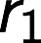
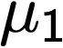
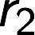
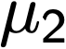
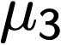
Review of UCB in the Single-Agent Case
Recall that multi-armed bandits provide a natural framework to understand exploration / exploitation trade-offs.
1
2
3
Notes:
arms are actions (what products to buy, or which restaurant to go to)
emphasize stochastic rewards

Slide 33
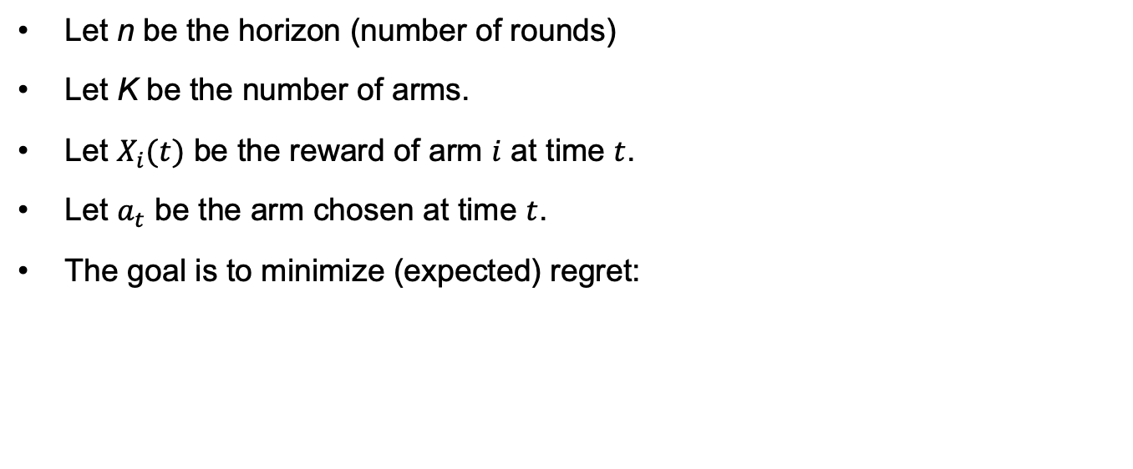
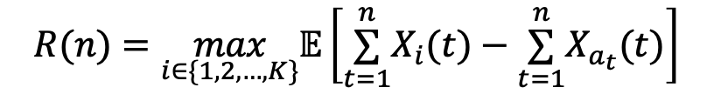
Notation
Let n be the horizon (number of rounds)
Let K be the number of arms.
Let $X_{i}(t)$ be the reward of arm $i$ at time $t$.
Let $a_{t}$ be the arm chosen at time $t$.
The goal is to minimize (expected) regret:
$$R(n)=\max_{i∈\{1,2,…,K\}}𝔼\left[\overset{n}{\underset{t=1}{∑}}X_{i}(t)−\overset{n}{\underset{t=1}{∑}}X_{a_{t}}(t)\right]$$
Total reward of best arm in hindsight
Reward obtained
University of California, Berkeley

Slide 34
UCB Algorithm
Choose the arm with the highest UCB
University of California, Berkeley

Slide 35
UCB Algorithm
Update UCB accordingly
University of California, Berkeley

Slide 36
UCB Algorithm
Now we sample this arm
University of California, Berkeley

Slide 37
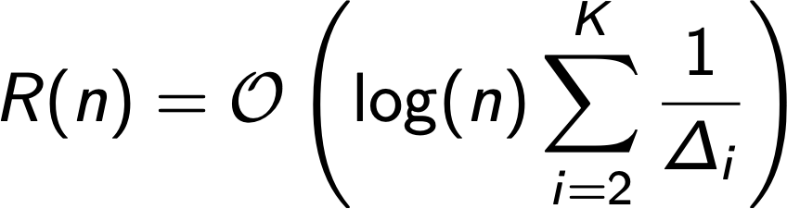
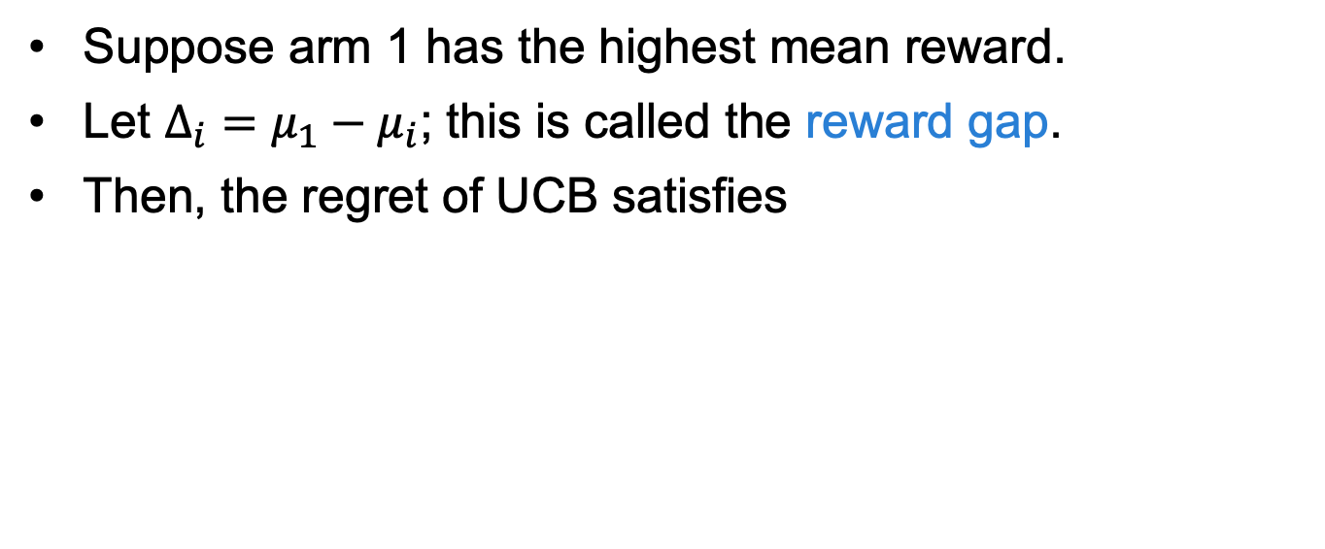
Regret of UCB
Suppose arm 1 has the highest mean reward.
Let $Δ_{i}=μ_{1}−μ_{i}$; this is called the reward gap.
Then, the regret of UCB satisfies
Notes:
horia

Slide 38
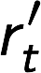
Multi-Player Bandits
Let’s add a competing player!
0
1
Bear wins conflict and gets the reward
2
3

Slide 39
Regret in Matching Markets
Suppose that there is some unique stable matching.
Players
Arms
?
1 > 2 > 3
1 > 3 > 2
2 > 3 > 1
3 > 1 > 2
1 > 2 > 3
2 > 1 > 3
Players should always choose their stable match in hindsight
Notes:
assuming perfect info about utilities, then each agent can expect to match to their stable match at every step (assuming unique stable matching). the summation is the actual expected reward

Slide 40
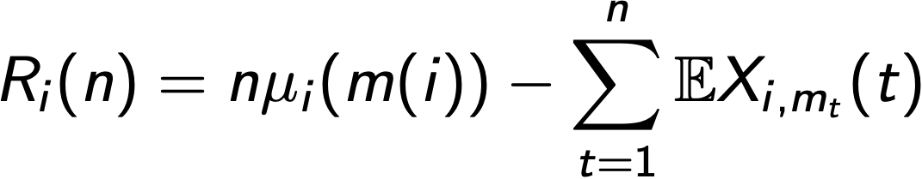
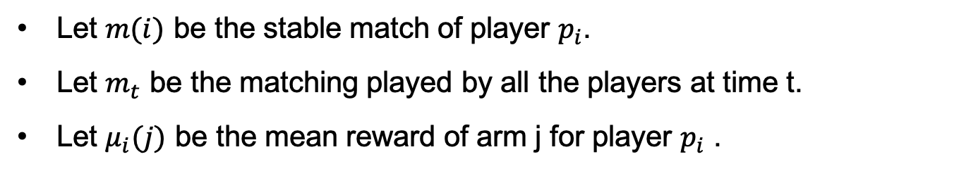
Regret in Matching Markets
Let $m(i)$ be the stable match of player $p_{i}$.
Let $m_{t}$ be the matching played by all the players at time t.
Let $μ_{i}(j)$ be the mean reward of arm j for player $p_{i}$ .
Define the stable regret of agent i up to time n as:
Mean reward of stable match
Reward at time t
Notes:
define m and mu first
assuming perfect info about utilities, then each agent can expect to match to their stable match at every step (assuming unique stable matching). the summation is the actual expected reward

Slide 41
Optimal vs Pessimal regret
Stable match may not be unique.
Pessimal Stable regret
Optimal Stable regret
___
___
Mean reward of worst stable match
Mean reward of worst stable match
___
___
Mean reward of best stable match
Mean reward of worst stable match

Slide 42
How to achieve a sequence of matchings that has low stable regret for all Players?
University of California, Berkeley

Slide 43
Centralized setting
The centralized setting is a design that involves a Matching Platform that communicates with all Players.
At every round:
Each Player submits current preferences to Platform.
Platform computes a matching, given preferences of Players and Arms.
Each Player is matched to Arm assigned by the Platform, receives reward.
University of California, Berkeley
Notes:
This centralized setting design is very general. Platform outputs some matching - may or may not be stable. It also does not assume whether the Players know the matching algorithm used by the platform, so they could submit preferences strategically. It’s a reasonable design to consider, because conflicts are potentially very costly (opportunity cost from outside options etc.) and the Matching Platform can ensure that Players do not conflict.

Slide 44
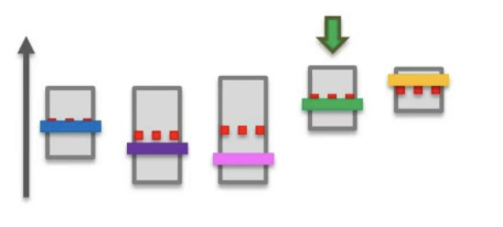
Algorithm: GS-UCB
Involves a Matching Platform that communicates with all Players.
At every round:
Players rank Arms by the UCBs of each Arm’s mean reward for themselves.
Platform runs the Gale-Shapley algorithm to match Players and Arms.
Players receive rewards from matched Arms and update their UCB for the Arm.
UCB
Mean rewards
Arms
University of California, Berkeley

Slide 45
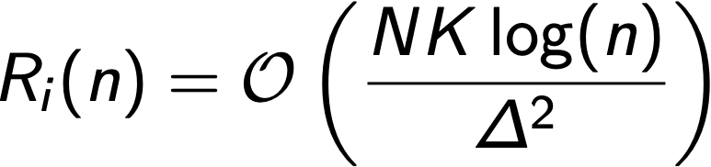
Regret of GS-UCB
Theorem (informal): If there are N players and K arms and GS-UCB is run, the stable (pessimal) regret of player i satisfies
Minimum gap of arms’ rewards for all players.
In other words, if one player has to explore more, another player incurs higher stable regret.
University of California, Berkeley

Slide 46
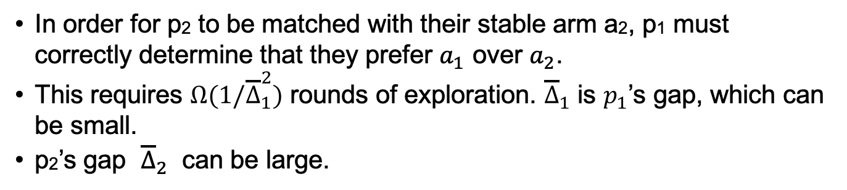

Dependence on $1/{Δ^{2}}$
a1 > a2
p1
a1
p1 > p2
a2 > a1
p2
a2
p1 > p2
In order for p2 to be matched with their stable arm a2, p1 must correctly determine that they prefer $a_{1}$ over $a_{2}$.
This requires $Ω(1/{\overline{Δ}}_{1}^{2})$ rounds of exploration. ${\overline{Δ}}_{1}$ is $p_{1}$’s gap, which can be small.
p2’s gap ${\overline{Δ}}_{2}$ can be large.
University of California, Berkeley

Slide 47
A puzzle
Gale-Shapley under known preferences guarantees the player-optimal matching
Gale-Shapley with preference learning (UCB) only has guarantees for the player-pessimal stable regret.
player-optimal regret can be linear in the worst case
Why?
Notes:
Not an artifact of our analysis.

Slide 48
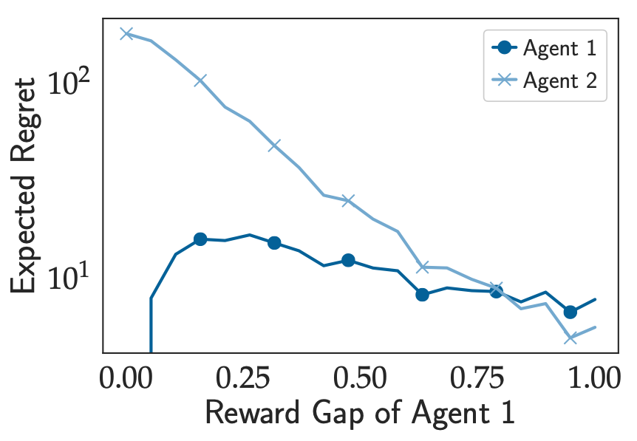
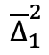
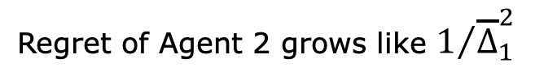
Dependence on $1/{Δ^{2}}$
$${\overline{Δ}}_{1}^{2}$$
Regret of Agent 2 grows like $1/{{\overline{Δ}}_{1}^{2}}$

Slide 49
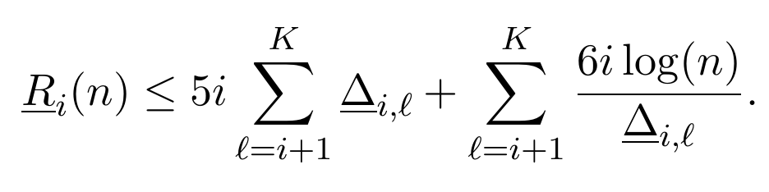
Special case: Global preferences
N Players all have the same ranking over Arms
K Arms all have the same ranking over Players
Arm/Player 1 is the most preferred etc. (everyone has the preference 1 > 2 > 3 > … > N)
In this setting, the pessimal regret of Player i is as follows:
Gap between Arm 𝓁 and pessimal stable Arm of Player i
University of California, Berkeley
Notes:
not N, but K. not worst case, special setting where regret only depends on own gaps.
this is a consequence

Slide 50
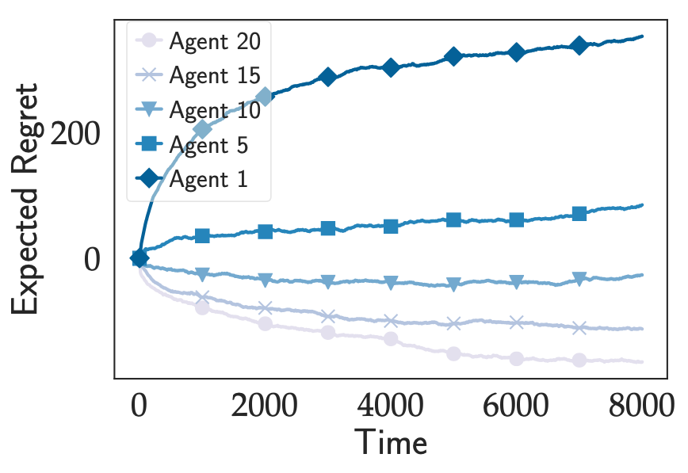
Global preferences (N=K=20)
Worst-ranked agent has negative regret (upper bound is 0)
Horizon, n
University of California, Berkeley

Slide 51
Incentive compatibility
Players must match with the Arm assigned by the Platform, but they can potentially submit preferences other than those based on their UCBs.
Q: How much can a Player improve their stable regret, if all other Players are submitting UCB preferences and the Platform is running GS?
A: Their (optimal) stable regret can be lower bounded by
Intuition: Player can only do better than their optimal stable arm if other players make ranking mistakes.
Ri(n) ≥ -O(log n)
University of California, Berkeley

Slide 52
Incentive compatibility
-O(log n) is achievable. Example: Global preferences
worst ranked agents have negative log n stable regret
Horizon, n
University of California, Berkeley

Slide 53
Summary
Many decision problems involve learning and economic thinking
We considered a multi-player bandit problem in the setting of matching markets
notion of Stable Regret
GS-UCB Algorithm
log(n) Player-Pessimal Stable Regret
Many open problems remain!
University of California, Berkeley

Slide 54
Proof Sketches
University of California, Berkeley

Slide 55
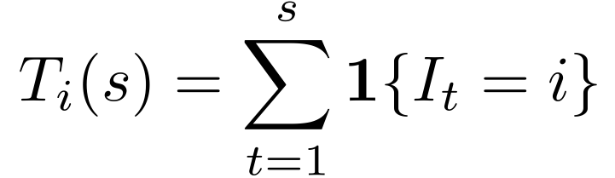
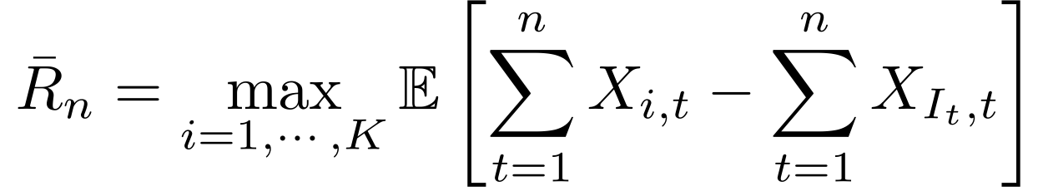
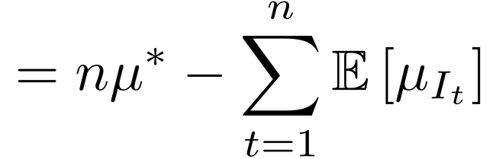
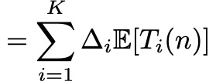
Single-agent UCB proof sketch
Number of times player pulled arm i after first s rounds
Regret decomposition
Gap between Arm i and Best Arm
University of California, Berkeley

Slide 56
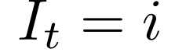
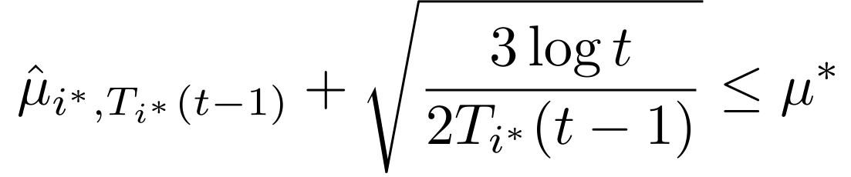
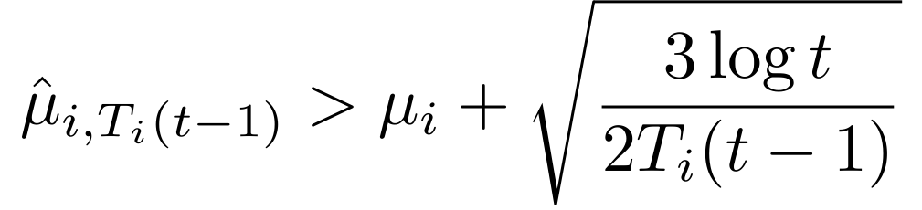
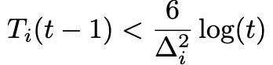
Single-agent UCB proof sketch
If , then one of the following must be true
Sample mean of best arm is too low
Sample mean of arm i is too high
Pulled arm i too few times, given how small the gap is
University of California, Berkeley

Slide 57
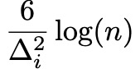
Single-agent UCB proof sketch
Pulling arm i because of Event C can at most happen times.
Probability of Event A and B can be bounded by a concentration inequality (Hoeffding)
can happen at most a constant number of times in expectation.
Reference: Bubeck and Cesa-Bianchi, 2012
University of California, Berkeley

Slide 58
Main theorem preliminaries
matching m: set of players → set of arms
blocking pair (pj, ak)
blocking triplet (pj, ak, ak’)
Set of all matchings blocked by a triplet (pj, ak, ak’) is Bj,j,k’
ak > m(j)
pj
ak
pj >m⁻¹(k)
m⁻¹(k)
m(j) = ak’
University of California, Berkeley
Notes:
To-do

Slide 59
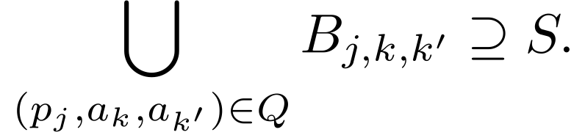
Main theorem preliminaries
Given a set S of matchings, a set Q of triplets cover S if
A matching m is full if all players are matched (N < K)
Mi,l : set of full matchings m such that m(pi)=al
Minimal covering of Mi,l : smallest set of blocking triplets that cover Mi,l
University of California, Berkeley
Notes:
To-do

Slide 60
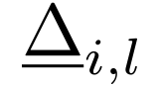
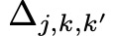
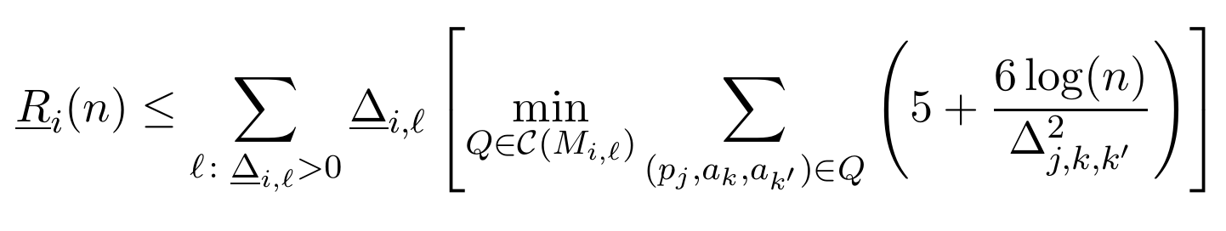
Main theorem preliminaries
Notation for reward gaps:
Mean reward gap between pessimal stable arm of Player i and Arm l for Player i , .
Mean reward gap between Arm k and k’ for Player j .
Main Theorem. The pessimal stable regret of GS-UCB is
University of California, Berkeley
Notes:
To-do

Slide 61
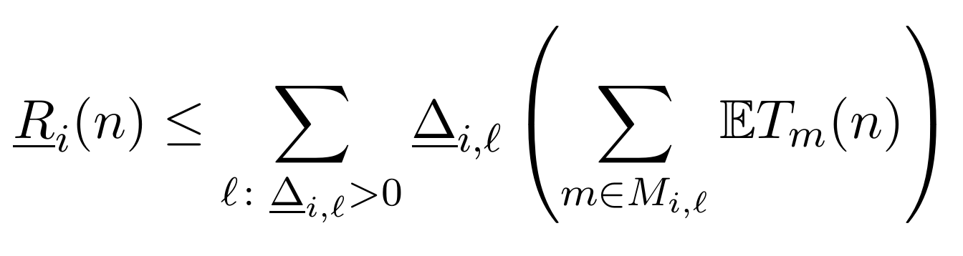
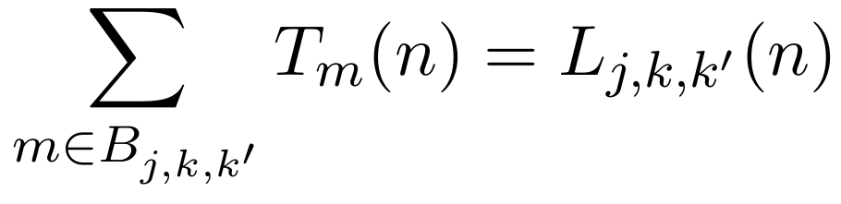
Main theorem proof
We may decompose regret by the number of times a matching happens.
Lj,k,k’(n) is the number of times (pj, ak, ak’) is a blocking triplet, i.e. pj pulls ak’, and pj ranks ak’ above ak by mistake.
University of California, Berkeley

Slide 62
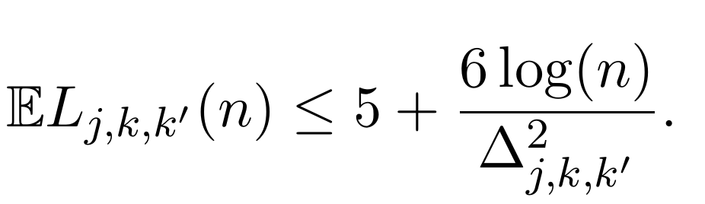
Main theorem proof
By the usual argument for UCB, we have
For more details, see [Liu et al., 2019].
University of California, Berkeley

Slide 63
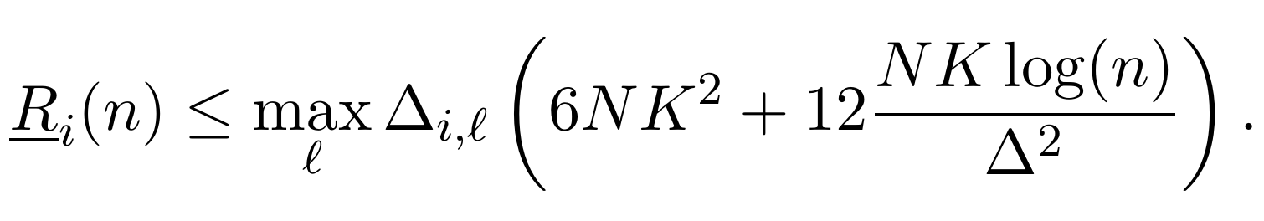
Corollary
Consider the covering: all (j,k,k’) where Player j prefers k to k’
This trivially covers Mi,l for all i and l.
Corollary.
__
Minimum gap between any pair of Arms’ rewards for any Player.
University of California, Berkeley

Slide 64
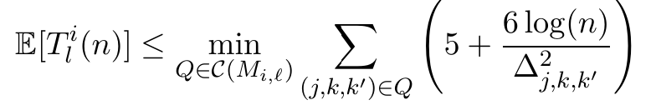
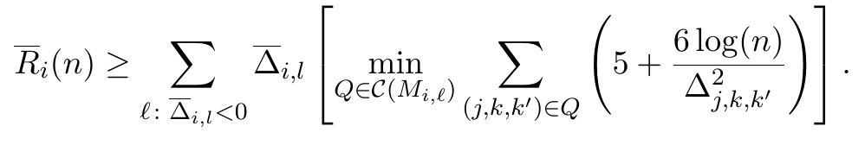
Proof sketch for incentive compatibility
Number of times Player i pulls Arm l where l is preferred to its optimal stable arm
Upper bound on Player-optimal regret
Gap between Arm 𝓁 and optimal stable Arm of Player i
Negative!
University of California, Berkeley
Notes:
whiteboard talk

